Slide 1
Greedy Algorithms
Optimal Merge Pattern
Huffman Encoding
Dr. Ramalingaswamy

Slide 2
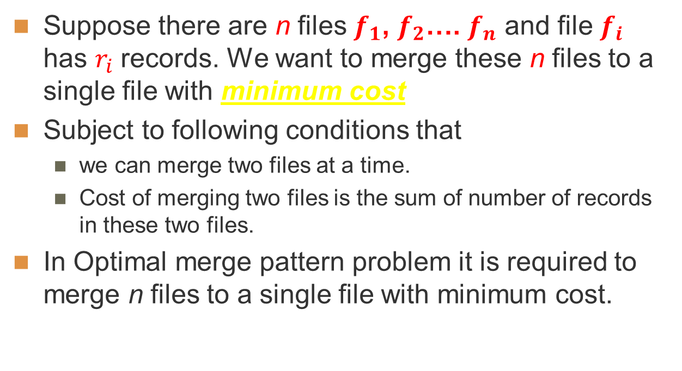
Informal Definition
Dr. Ramalingaswamy

Slide 3
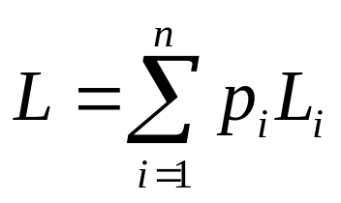
Optimal Merge Patterns: Formal Definition
Binary Merge Tree:
A binary tree with external nodes representing entities (files, lists etc..) and internal nodes representing merging cost of these entities.
Optimal Binary Merge Tree:
The sum of paths from root to external nodes is optimal (e.g. minimum). Assuming that the node (i) contributes to the cost by p_{i} and the path from root to such node has length L_{i}, then optimality requires a pattern that minimizes
Dr. Ramalingaswamy

Slide 4
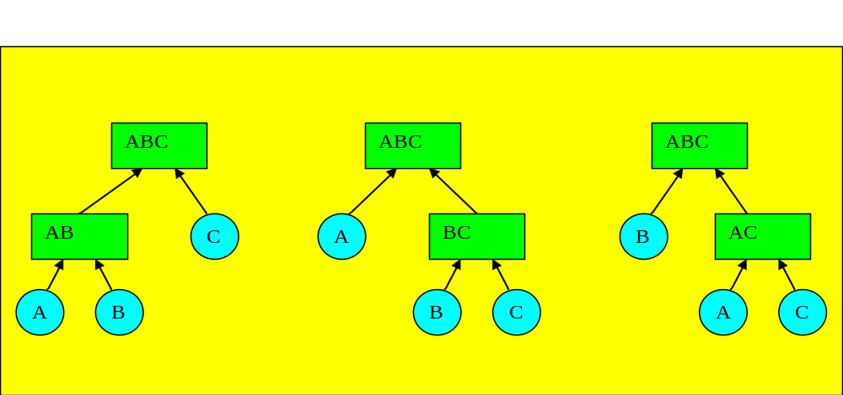
Optimal Binary Merge Tree
If the items {A,B,C} contribute to the merge cost by P_{A} , P_{B} , P_{C}, respectively, then the following 3 different patterns will cost:
P₁= 2(P_{A}+P_{B})+P_{C} P₂ = P_{A}+2(P_{B}+P_{C}) P₃ = 2P_{A}+P_{B}+2P_{C}
Which of these merge patterns is optimal?
Dr. Ramalingaswamy

Slide 5
(b) Optimal Merging of Lists
Lists {A,B,C} have lengths 30,25,10, respectively. The cost of merging two lists of lengths n,m is n+m. The following 3 different merge patterns will cost:
P₁= 2(30+25)+10 = 120 P₂ = 30+2(25+10) = 100 P₃ = 25+2(30+10) = 105
P₂ is optimal so that the merge order is {{B,C},A}.
Dr. Ramalingaswamy

Slide 6
The Greedy Method
Insert lists and their lengths in a minimum heap of lengths.
Repeat
  Remove the two lowest length lists (p_{i} ,p_{j}) from heap.
  Merge lists with lengths (p_{i},p_{j}) to form a new list with length p_{ij} = p_{i}+ p_{j}
  Insert p_{ij} and its symbols into the heap
until all symbols are merged into one final list
C | 10
B | 25 | A | 30
A | 30 | BC | 35 | BCA | 65
Dr. Ramalingaswamy

Slide 7
The Greedy Method
Notice that both Lists (B : 25 elements) and (C : 10 elements) have been merged (moved) twice
List (A : 30 elements) has been merged (moved) only once.
Hence the total number of element moves is 100.
This is optimal among the other merge patterns.
Dr. Ramalingaswamy

Slide 8
(c) Huffman Coding
Terminology
Symbol:
A one-to-one representation of a single entity.
Alphabet:
A finite set of symbols.
Message:
A sequence of symbols.
Encoding:
Translating symbols to a string of bits.
Decoding:
The reverse.
Dr. Ramalingaswamy

Slide 9
Encoding
Consider standard codes like ASCII (8 bits)
It is a fixed length coding i.e., all the characters are encoded using same number of bits.
In fixed length code the total code length is more.
Dr. Ramalingaswamy

Slide 10
Fixed length Encoding
Example: Let us have {a, b, c, d, e, f} characters and their frequency of occurrences in a string are {45, 13, 12, 16, 9, 5}. As per ASCII fixed-length scheme each letter requires 8 bits. Then, the total number of bits required to encode the string is
` (45+13+12+16+9+5)*8 =800 bits
Dr. Ramalingaswamy

Slide 11
Example: Coding Tree for 4-Symbol Alphabet (a,b,c,d)
Encoding:
a 00
b 01
c 10
d 11
Decoding:
0110001100
b c a d a
This is fixed length coding
abcd
0
1
ab
cd
0
1
0
1
a
b
c
d
Dr. Ramalingaswamy

Slide 12
Variable length Encoding
Character | a | b | c | d | e | f
Frequency | 45 | 13 | 12 | 16 | 9 | 5
Prefix code | 0 | 101 | 100 | 111 | 1101 | 1100
The total number of bits required to encode the string is
(1*45)+(3*13)+(3*12)+(3*16)+(4*9)+(4*5) = 224 bits
Problem statement:
  How to find the minimum length bit string for each character (prefix code) which can be used to encode a string of symbols such that the total number of bits for encode a string is minimum.
Application: text compression:
Dr. Ramalingaswamy

Slide 13
Coding Efficiency & Redundancy
L_{i} =Length of path from root to symbol (i) = no. of bits representing that symbol.
P_{i} = probability of occurrence of symbol (i) in message.
n = size of alphabet.
< L > = Average Symbol Length = Σ_{1≤ i ≤ n} P_{i} L_{i} bits/symbol (bps)
For fixed length coding, L_{i} = L = constant, < L > = L (bps)
Is this optimal (minimum) ? Not necessarily.
Dr. Ramalingaswamy

Slide 14
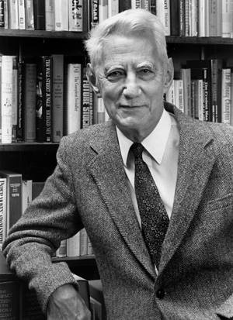
Coding Efficiency & Redundancy
The absolute minimum < L > in a message is called the Entropy.
The concept of entropy as a measure of the average content of information in a message has been introduced by Claude Shannon (1948).
Dr. Ramalingaswamy

Slide 15
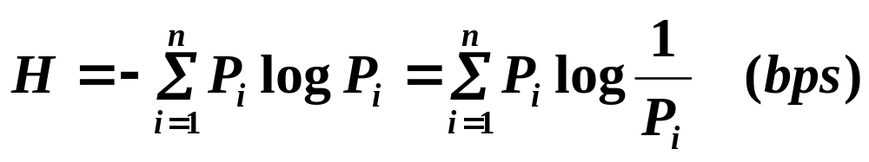
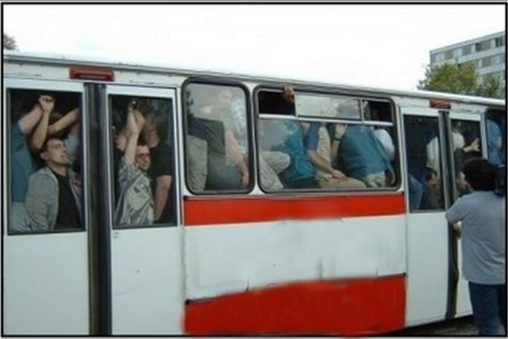
Coding Efficiency & Redundancy
Shannon's entropy represents an absolute limit on the best possible lossless compression of any communication. It is computed as:
Dr. Ramalingaswamy

Slide 16
Coding Efficiency & Redundancy
Coding Efficiency: η = H / < L > 0 ≤ η ≤ 1
Coding Redundancy: R = 1 - η 0 ≤ R ≤ 1
Actual <L>
Optimal <L>
H
Perfect <L>
Dr. Ramalingaswamy

Slide 17
Example: Fixed Length Coding
4- Symbol Alphabet (a,b,c,d). All symbols have the same length L = 2 bits
Message : abbcaada
< L > = 2 (bps)
Symbol (i) | p_{i} | -log p_{i} | -p_{i} log p_{i} | code | L_{i}
a | 0.5 | 1 | 0.5 | 00 | 2
b | 0.25 | 2 | 0.5 | 01 | 2
c | 0.125 | 3 | 0.375 | 10 | 2
d | 0.125 | 3 | 0.375 | 11 | 2
H = 1.75
Dr. Ramalingaswamy

Slide 18
Example
Entropy
H = 0.5 + 0.5 + 0.375 + 0.375 = 1.75 (bps),
Coding Efficiency
η = H / < L > = 1.75 / 2 = 0.875,
Coding Redundancy
R = 1 – 0.875 = 0.125
This is not optimal
Dr. Ramalingaswamy

Slide 19
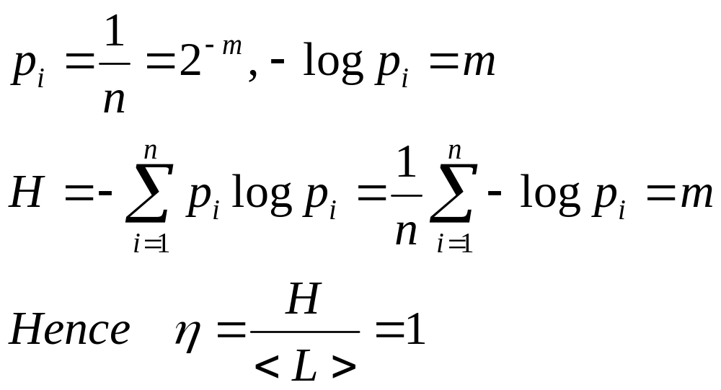
Result
Fixed length coding is optimal (perfect) only when all symbol probabilities are equal.
To prove this:
With n = 2^{m} symbols, L = m bits and <L> = m (bps).
If all probabilities are equal,
Dr. Ramalingaswamy

Slide 20
Huffman coding
Huffman coding is a lossless data compression algorithm.
The idea is to assign variable-length codes to input characters, lengths of the assigned codes are based on the frequencies of corresponding characters.
The most frequent character gets the smallest code and the least frequent character gets the largest code.
The variable-length codes assigned to input characters are Prefix Codes, means the codes (bit sequences) are assigned in such a way that the code assigned to one character is not prefix of code assigned to any other character.
This is how Huffman Coding makes sure that there is no ambiguity when decoding the generated bit stream.
Dr. Ramalingaswamy

Slide 21
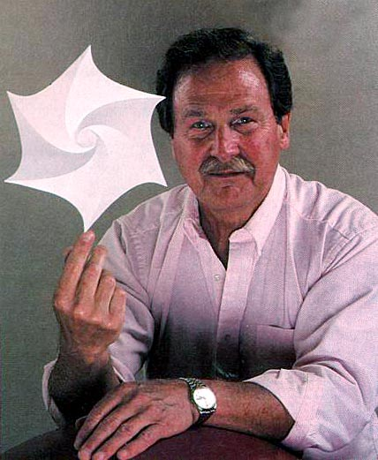
Variable Length Coding
(Huffman Coding)
The problem:
Given a set of symbols and their
probabilities
Find a set of binary codewords
that minimize the average
length of the symbols
Dr. Ramalingaswamy

Slide 22
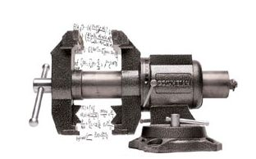
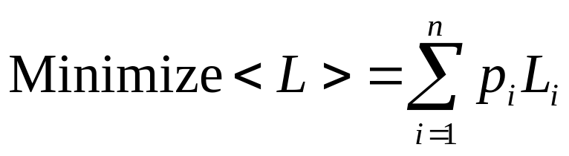
Variable Length Coding
(Huffman Coding)
Formally:
Input: A message M(A,P) with
a symbol alphabet A = {a₁,a₂,…,a_{n}} of size (n)
a set of probabilities for the symbols P = {p₁,p₂,….p_{n}}
Output: A set of binary codewords C = {c₁,c₂,….c_{n}} with bit lengths L = {L₁,L₂,….L_{n}}
Condition:
Dr. Ramalingaswamy

Slide 23
Variable Length Coding
(Huffman Coding)
To achieve optimality, we use optimal binary merge trees to code symbols of unequal probabilities.
Huffman Coding:
More frequent symbols occur nearer to the root ( shorter code lengths), less frequent symbols occur at deeper levels (longer code lengths).
Dr. Ramalingaswamy

Slide 24
The Greedy Method
Store each symbol in a parentless node of a binary tree.
Insert symbols and their probabilities in a minimum heap
of probabilities.
Repeat
  Remove lowest two probabilities (p_{i} ,p_{j}) from heap.
  Merge symbols with (p_{i},p_{j}) to form a new symbol (a_{i}a_{j}) with
  probability p_{ij} = p_{i}+ p_{j}
  Store symbol (a_{i}a_{j}) in a parentless node with two children a_{i} and a_{j}
  Insert p_{ij} and its symbols into the heap
until all symbols are merged into one final alphabet (root)
Trace path from root to each leaf (symbol) to form the bit string for that symbol. Concatenate “0” for a left branch, and “1” for a right branch.
Dr. Ramalingaswamy

Slide 25
Example (1):
4- Symbol Alphabet A = {a, b, c, d} of size (4).
Message M(A,P) : abbcaada, P = {0.5, 0.25, 0.125, 0.125}
H = 1.75
Symbol (i) | p_{i} | -log p_{i} | -p_{i} log p_{i}
a | 0.5 | 1 | 0.5
b | 0.25 | 2 | 0.5
c | 0.125 | 3 | 0.375
d | 0.125 | 3 | 0.375
Dr. Ramalingaswamy

Slide 26
Building The Optimal Merge Table
s_{i} | p_{i} | s_{i} | p_{i} | s_{i} | p_{i} | s_{i} | p_{i}
d | 0.125
c | 0.125 | cd | 0.25
b | 0.25 | b | 0.25 | bcd | 0.5
a | 0.5 | a | 0.5 | a | 0.5 | abcd | 1.0
Dr. Ramalingaswamy

Slide 27
Optimal Merge Tree for Example(1)
Example:
a (50%), b (25%), c (12.5%), d (12.5%)
a
b
c
d
Dr. Ramalingaswamy

Slide 28
Optimal Merge Tree for Example(1)
Example:
a (50%), b (25%), c (12.5%), d (12.5%)
cd
0
1
a
b
c
d
Dr. Ramalingaswamy

Slide 29
Optimal Merge Tree for Example(1)
Example:
a (50%), b (25%), c (12.5%), d (12.5%)
bcd
1
0
b
cd
0
1
a
c
d
Dr. Ramalingaswamy

Slide 30
Optimal Merge Tree for Example(1)
Example:
a (50%), b (25%), c (12.5%), d (12.5%)
a_{i} | c_{i} | L_{i} (bits)
a | 0 | 1
b | 10 | 2
c | 110 | 3
d | 111 | 3
abcd
0
1
a
bcd
1
0
b
cd
0
1
c
d
Dr. Ramalingaswamy

Slide 31
Coding Efficiency for Example(1)
< L > = ( 1* 0.5 + 2 * 0.25 + 3 * 0.125 + 3 * 0.125) = 1.75 (bps)
H = 0.5 + 0.5 + 0.375 + 0.375 = 1.75 (bps),
η = H / < L > = 1.75 / 1.75 = 1.00 , R = 0.0
Notice that:
Symbols exist at leaves, i.e., no symbol code is the prefix of another symbol code.
This is why the method is also called
“prefix coding”
Dr. Ramalingaswamy

Slide 32
Analysis
The cost of insertion in a minimum heap is O(n logn)
The repeat loop is done (n-1) times.
In each iteration, the worst case removal of the least two elements is 2 logn and the insertion of the merged element is logn
Hence, the complexity of the Huffman algorithm is
O(n logn)
Dr. Ramalingaswamy

Slide 33
Example (2):
4- Symbol Alphabet A = {a, b, c, d} of size (4).
P = {0.4, 0.25, 0.18, 0.17}
H = 1.909
Symbol (i) | p_{i} | -log p_{i} | -p_{i} log p_{i}
a | 0.40 | 1.322 | 0.5288
b | 0.25 | 2 | 0.5
c | 0.18 | 2.474 | 0.4453
d | 0.17 | 2.556 | 0.4345
Dr. Ramalingaswamy

Slide 34
Example(2): Merge Table
s_{i} | p_{i} | s_{i} | p_{i} | s_{i} | p_{i} | s_{i} | p_{i}
d | 0.17
c | 0.18 | b | 0.25
b | 0.25 | cd | 0.35 | a | 0.40
a | 0.40 | a | 0.40 | cdb | 0.60 | cdba | 1.0
Dr. Ramalingaswamy

Slide 35
Optimal Merge Tree for Example(2)
a_{i} | c_{i} | L_{i} (bits)
a | 1 | 1
b | 01 | 2
c | 001 | 3
d | 000 | 3
cdba
0
1
cdb
a
0
1
cd
b
0
1
c
d
Dr. Ramalingaswamy

Slide 36
Coding Efficiency for Example(2)
a (40%), b (25%), c (18%), d (17%)
<L> = 1.95 bps (Optimal)
H = 1.909
η = 97.9 %
R = 2.1 %
Dr. Ramalingaswamy

Slide 37
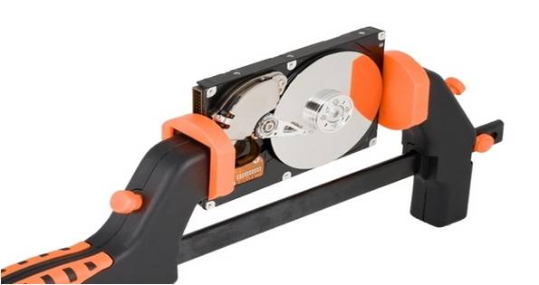
Application: File Compression
Variable Length Codes can be used to compress files. Symbols are initially coded using ASCII (8-bit) fixed length codes.
Steps:
1. Determine Probabilities of symbols in file.
2. Build Merge Tree (or Table)
3. Assign variable length codes to symbols.
4. Encode symbols using new codes.
5. Save coded symbols in another file together with the symbol code table.
The Compression Ratio = < L > / 8
Dr. Ramalingaswamy

Slide 38
Huffman Coding Animations
For examples of animations of Huffman coding, see:
http://www.cs.pitt.edu/~kirk/cs1501/animations
Huffman.html
http://peter.bittner.it/tugraz/huffmancoding.html
Dr. Ramalingaswamy

